Slide 1
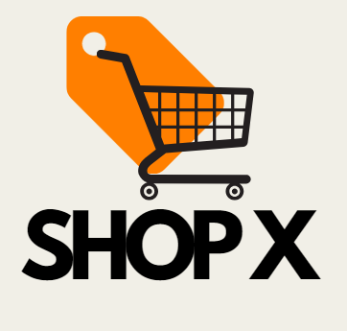
Streamlining Success: Optimizing ShopX Operations
Jared F. Torres, Isabela S. Castro, Juan Zavala, Jacquelin Valdez, and Ayoub Hizam

Slide 2
TABLE OF CONTENTS
03
05
04
02
01
VENDOR ALIGNMENT FOR PRODUCT EFFICIENCY
EFFICIENCY
STRATEGIES OVERVIEW
CONCLUSION
SHOPX STATS
SHOPX PLUS

Slide 3
01: EFFICIENCY STRATEGIES OVERVIEW
Our Key Recommendations:
Shop X Plus
ShopX+ members get guaranteed faster delivery for a fixed price, meeting their need for quick service
The program builds loyalty through reward points while ensuring customers receive products sooner
Vendor alignment for product efficiency
Match each product with the fastest-delivering vendor for that item
Using speedy vendors improves customer satisfaction through quicker delivery times
ShopX is a rapidly expanding e-commerce company, facing increasing demand for its diverse range of lifestyle products.
To maintain its competitive edge, we have identified three key strategies enhancing:
Product efficiency
Transportation logistics
Customer satisfaction.

Slide 4
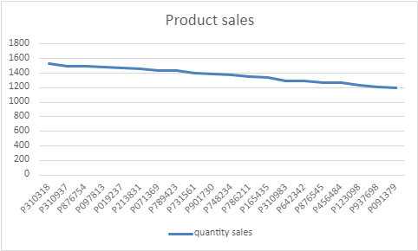
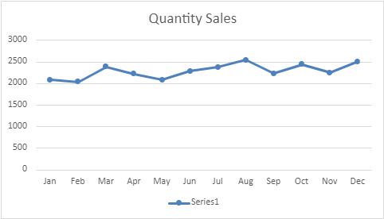
02: ShopX Stats
Top Product sales
Travel Pillow = $19.99
Journal= $4.99
Water Bottle =$14.99
Best month sales
August
December
October
Shipping
Worst month sales
January
February
May
Least Products sales
Succulent Plant= $5.00
LED Lights=$49.99
Silk Pillowcase=$19.99
Express Shipping = 2 days avg
Standard Shipping=9 days avg

Slide 5
03: Vendor alignment for product efficiency
Data Findings:
Risks:
Multiple vendors are supplying the same products
Some vendors regularly have shipping delays while others don't for the same product
Vendor Dependency: Too much dependency on any single vendor makes us vulnerable to their problems (supply issues, labor shortages, etc.)
Limited Flexibility: We lose sourcing flexibility – if market conditions change or issues arise, having one assigned vendor makes it harder to pivot
Pricing Power: Preferred vendors gain negotiating power – knowing they're our main supplier for certain items, they could increase prices
Development:
Match products to the vendors who deliver them quickest, thus improving efficiency

Slide 6
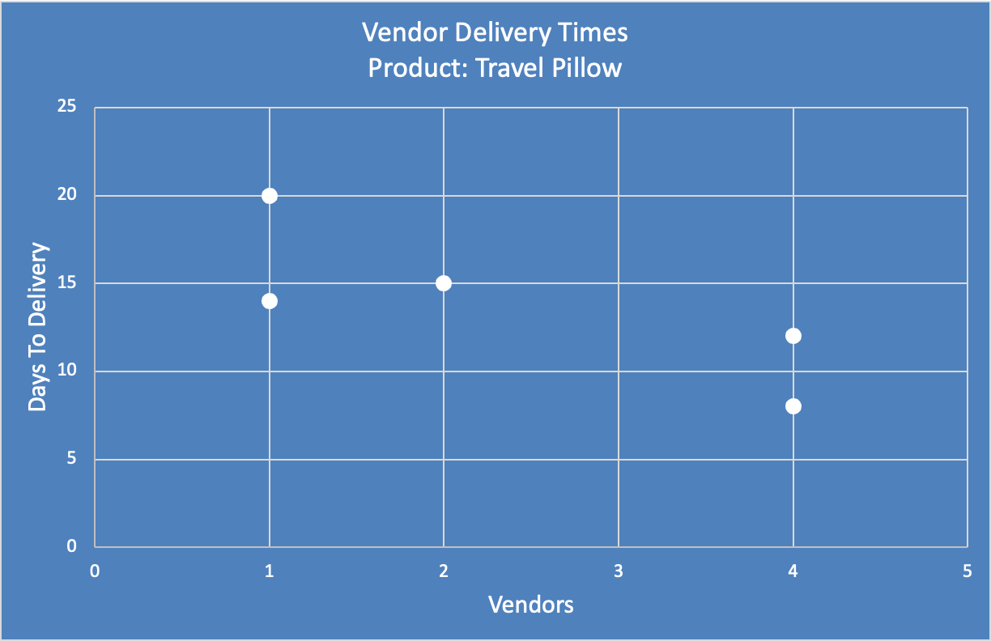
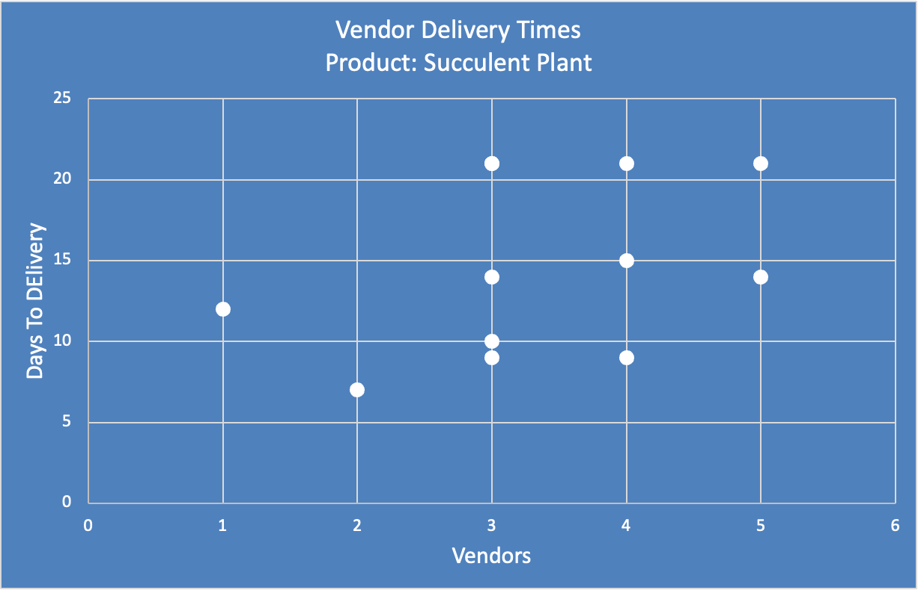
Vendor Delivery Times Chart

Slide 7
Suggested vendor use
Product | Vendor
Casual Vest | 1
Air Fryer | 1
College Mug | 1
Quilt | 1
Scented Candle | 1
Deskwide Mousepad | 1
LED Lights | 1
Succulent Plant | 2
Yoga Mat | 3
Sleep Mask | 3
Journal | 3
Silk Pillowcase | 3
Heart Shaped Wall Mirror | 3
Tote Bag | 4
Noise-Cancelling Headphones | 4
Phone Case | 4
Cookbook | 4
Water Bottle | 5
Keyboard Wrist Rest | 5
Travel Pillow | 8
Updated version of Vendors
Using these vendors for their designated Product will keep the vendors delivery days between 7 and 9 days
Otherwise, it would be from 7 to 21

Slide 8





03: Vendor alignment for product efficiency mitigation
Establish Contingency Plans: Develop contingency plans for potential disruptions that may occur, including backup vendors and alternative sourcing strategies.
Regular Performance Reviews: Conduct regular assessments of vendor performance, including delivery times, product quality, and responsiveness.
Diversify Vendor Relationships: Maintain relationships with multiple vendors for each product to ensure alternatives are available in case one vendor encounters issues.
Contract Flexibility: Negotiate contracts that include clauses for flexibility in pricing and delivery times, allowing for adjustments based on market conditions or vendor performance.

Slide 9
04: Shop X Plus
Goal
c
Risk
We currently have 52 % of clients using express, our goal is to increase this number to 70 %
Client does not value the Shop X Plus:
Orders will remain to be delayed, causing customer dissatisfaction and a decrease in retention rate
Cost to Implement a Shop X Plus:
Developing custom software for efficient inventory management can be costly, involving expenses for design, development, testing, and ongoing maintenance
Inventory Management:
To guarantee fast shipping, we need efficient inventory management. If stock runs out in restocking, we risk upsetting customers
Approach
We gather the Express shipping vendor for client to use, and determine which vendor fits best for the client and the company (Time, Price)
End product
Customers will be able to choose between Shop X and Shop X Plus. Over time, the reward points will encourage customers to continue using Shop X Plus, boosting retention and encouraging repeat purchases

Slide 10
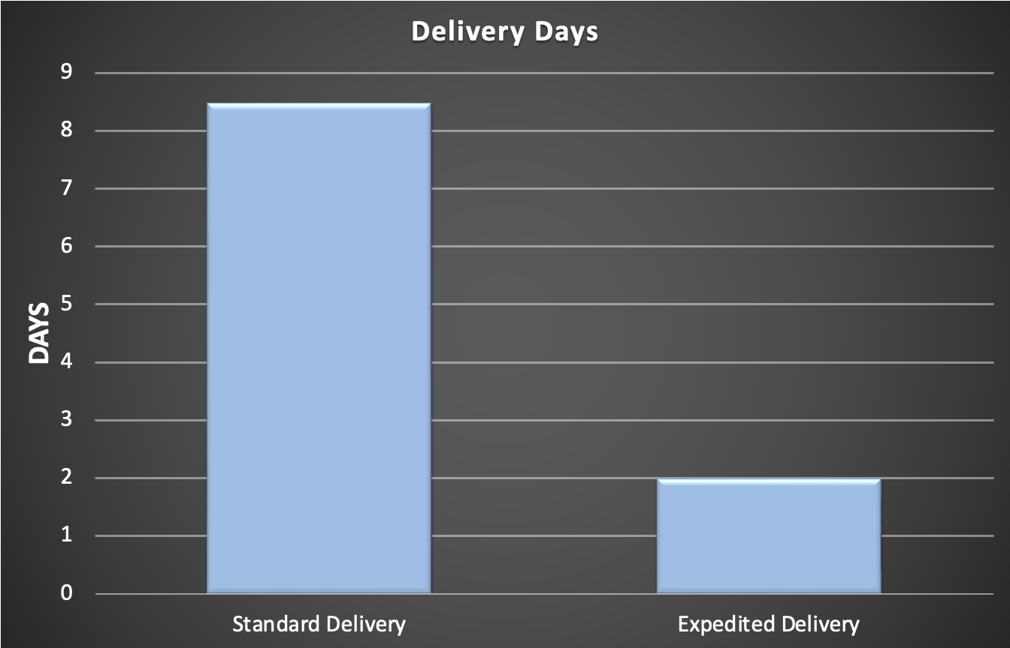
Delivery visualization
Shop X: Standard product offering with regular shipping times and no added benefits.
Shop X Plus: Premium product offering with faster shipping, where customers earn reward points for each purchase.

Slide 11
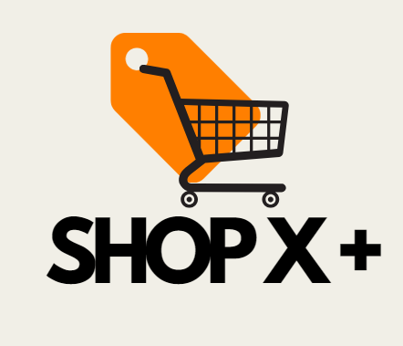
Shop X Plus
Only Two Options for shipping Purchase:
Reducing the clients option of shipping from 5 different choices to only 2.
Customer retention:
Aims for customer retention by Cutting down time on delivery and enhancing the purchase experience.
Point System
Clients will be able to earn points based on 10% of their product(s) payment.
Ex: $100 will be worth 10 points
Every 100 points counts as a tier up where clients can receive discounts, money-back, and special offers.

Slide 12
05: CONCLUSION
Faster and Reliable Deliveries with Shop X Plus:
The implementation of Shop X Plus offers customers a faster and more reliable product delivery service, boosting customer satisfaction and loyalty.
Customers will be given two choices—Shop X or Shop X Plus—where customers can benefit from quicker delivery times, incentivized by reward points.
Vendor Alignment for Product Efficiency:
To improve product efficiency, connect products with vendors that deliver the fastest to reduce shipping delays.
A vendor alignment approach will streamline operations, improve delivery times, and ultimately enhance customer satisfaction.

Slide 13
Questions?

Slide 14
